Slide 1


Slide 2

Java OOP and Data Structures with Introduction to Secure Coding Dr. Ziping Liu
Chapter 21 Hashing

Slide 3
https://he.kendallhunt.com/product/java-oop-and-data-structures-introduction-secure-coding
Chapter 21 Hashing

Slide 4

Chapter Outlines
What is hashing
hashCode() explanation
Techniques to handle collision
A simple hash table example
Discussion of hash map implementation using linear probing
Discussion of hash map implementation using separate chaining
Discussion of Java Collection HashMap

Slide 5
21.1 What Is Hashing?
using a hash function to compute a hash code - fixed-size integer value, from keys - data of arbitrary size
the hash codes are then used to determine the indices of a fixed-size array, called a hash table, where related information about the keys is stored
the process of mapping keys to their corresponding values in a hash table using hash codes as indices is referred to as hashing
hashing enables the efficient mapping of key-value pairs

Slide 6
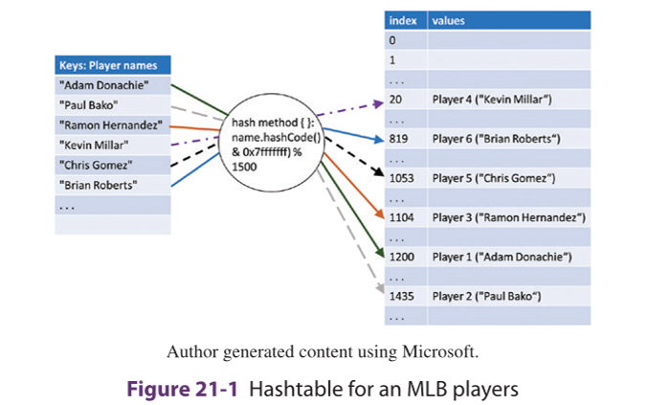
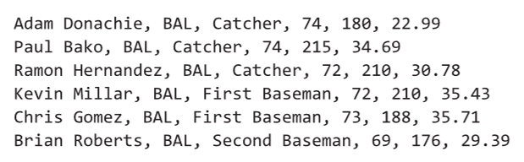
21.1 What Is Hashing?
Major League Baseball players

Slide 7
21.1 What Is Hashing?
a hash function adheres to the following principles:
It returns an integer value for an object.
One-Way: It's computationally easy to generate a hash from the input, but it's computationally infeasible to reverse the process—meaning, you can't easily get the original input from the hash value alone.
If two objects are defined as equal, their hash codes must be identical.
Deterministic: The same input will always produce the same hash output.
If two objects are not equal, their hash codes may or may not be the same.
Collision Resistance (Ideally): It's computationally difficult to find two different inputs that produce the exact same hash output.

Slide 8
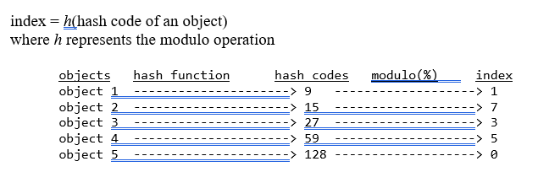
21.1 What Is Hashing?
fast lookup with a time complexity of O(1) for a collection of objects involves storing them in an array of size N

Slide 9
21.2 hashCode( ) Explanation
To calculate the hash code for an object, Java provides the hashCode() method in its Object class, and other classes can override it to provide their own specific implementations.
It is recommended to override the hashCode() method whenever the equals() method is overridden. This ensures consistency with the general contract of the hashCode() method, which states that equal objects must have equal hash codes.

Slide 10
21.2 hashCode( ) Explanation
The hashCode() method returns hash code
For an Integer object, returns the integer value itself.
For a Character object, returns the character’s Unicode value.
For a String object, computes the hash code using the following formula:
s[0]*31^(n-1) + s[1]*31^(n-2) + ... + s[n-1]
Here, s represents the String object, and n is its length.

Slide 11
21.2 hashCode( ) Explanation
For a user-defined class, if all fields of a user-defined class have known hash codes or hashCode() methods, you can utilize the hash() method from the Java Objects class—a utility class providing a group of static methods that simplify deployment without creating an object.
if a class A has fields x, y, and z, the overridden hashCode() method can be implemented as:
@Override
public int hashCode() {
return Objects.hash(x, y, z);
}

Slide 12
21.2 hashCode( ) Explanation
The equals() method can be coded as:
@Override
public boolean equals(Object o) {
if (o == this) return true;
if (!(o instanceof A)) {
return false;
}
A a = (A) o;
return Objects.equals(x, a.x) && Objects.equals(y, a.y) && Objects.equals(z, a.z);
}

Slide 13
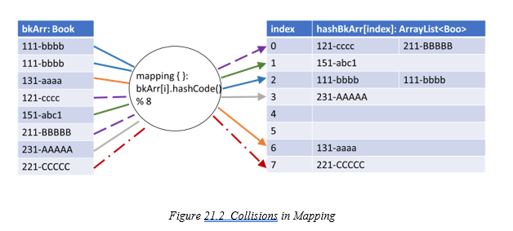
21.3 Techniques to Handle Collision

Slide 14
21.3 Techniques to Handle Collision
When multiple keys map to the same calculated index, it is referred to as a collision. To resolve collisions in a hash table, two common approaches are used: open addressing and separate chaining.
In open addressing, the elements of the array directly store the key-value pairs. If a collision occurs, the algorithm searches for the next available slot in the array using a specific probing technique.
In separate chaining, the elements of the array store a linked data structure, such as a linked list, containing all the values that map to the same index.

Slide 15
21.3 Techniques to Handle Collision
There are three common approaches for open addressing: linear probing, quadratic probing, and double hashing.
In linear probing, if an index i is calculated using the hash function and the corresponding slot is already occupied, the algorithm checks the next slot at i+1. If i+1 is also occupied, it continues checking subsequent slots (i+2, i+3, …) until an empty slot is found to store the value. In this approach, the offset from the original slot is always 1, 2, 3, etc. If the number of values is equal to the array size, all values can be stored in the array. However, excessive collisions can disrupt the original mapping created by the hash function f(), potentially leading to exhaustive lookups instead of the expected O(1) performance. Another drawback of linear probing is that values tend to cluster together, causing primary clustering.
Quadratic probing addresses the clustering issue by checking slots at increasing quadratic offsets instead of sequential ones. If a collision occurs, the algorithm examines the slot at i+j^2, where j starts at 1 and increments if the slot is already occupied. For example, it checks slots i+1, i+4, i+9,…. This reduces clustering compared to linear probing. However, a downside of quadratic probing is that not all values are guaranteed to find an available slot.
Double hashing employs a secondary hash function f’(key) in addition to the primary hash function f(key). Typically, the primary hash function is defined as f(key) = key % N, while the secondary hash function is defined as f’(key) = constant – key % N. When a collision occurs, the secondary hash function determines the step size for probing. The index is calculated as i + j * f’(key), where j takes on values 0, 1, 2, 3, etc. Double hashing minimizes clustering and provides a more uniform distribution of values.

Slide 16
21.4 A Simple Hash Table Example
JavaHashTableEx example: design a simple hash table data structure.

Slide 17
21.5 Discussion of HashMap Implementation using Linear Probing
In the Java Collection Framework, Map is used to store key-value pairs, and HashMap utilizes hashing for array indexing. In our JavaHashMapEx example, we will demonstrate our implementation of a HashMap using linear probing.

Slide 18
21.6 Discussion of HashMap Implementation using Separate Chaining
JavaHashMapSChain: implement our version of HashMap using separate chaining

Slide 19
21.7 Discussion of Java Collection HashMap
import the java.util.HashMap class to create a HashMap instance

Slide 20


Slide 21


Slide 22
Which National Natural Landmark is it?
Answer: Koʻolau Range

